Slide 1
Service Learning At WPC Who are we? FOR the city
Eli Ritchie

Slide 2
Service at WP
Liberal Arts
Urban
Christ-Centered
Diverse
“In the City, For the City”
Notes:
At this point, we talk a little about the stated “Core Themes” of the college, and relate community engagement to the core identity of the college.

Slide 3
Why Serve Portland?
In Portland's class of 2011 alone, 1,300 students -- 35 percent of the class -- failed to earn a diploma in four years
Portland has made national headlines as a major hub of human trafficking on the west coast
Rising percentages of children and families living under the federal poverty line
High rates of food-insecurity
You have an opportunity to make a difference
Notes:
I’ll update this for the coming year, but this involves a little discussion around the opportunities that exist in Portland

Slide 4
How to do Service Well
Use an Asset-Based approach
Use your passions and skills
Connect service to what you are learning
Get Invested
Long Term – Most impact
Build Relationships
Reflect
By Yourself
With a group
Learn and Apply
Notes:
Connecting service and learning is a new concept to most of our incoming students. They are used to seeing a need and reacting, rather than finding an “opportunity” that engages their unique skill set, which will allow them to have the greatest possible impact.

Slide 5
What Service IS NOT
Notes:
At this point I talk a little about the “Savior” ideal in students, which I see most prevalent with the students who are coming to Warner out of its traditional Church of God base. These students are very likely to engage in service, but usually in short-term opportunities, and often do not realize that serving needs to be a practice that encourages a “with” mentality, rather than a “for” mentality.

Slide 6
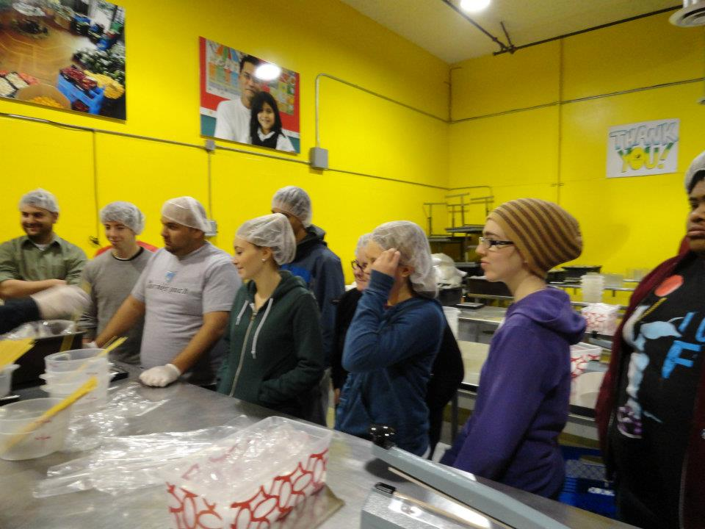
Service at WP
Common Day of Service
MLK Day
Spring Break
Service with clubs and student organizations
Saturday Serve
Curricular Service
Public Schools
Hot Chocolate Ministries
What are you Passionate About?
Notes:
In this section I talk a little about the service opportunities that exist through our office

Slide 7
Service Commitment
Service Requirement…
10 Service Hours and 15 Chapels (Residential)
25 total hours with at least 5 Service Hours and Chapels (Commuter)
At WPC, we define Service as…
Benefiting those who are within personal proximity & experiencing poverty.
Love one’s neighbor and to care for those in our society with authentic need
Matthew 19
Notes:
This is a discussion of the Faith and Service “commitment”

Slide 8
Can Service Benefit me?
Is that okay?
Your Education is (Partly) About Your Future
Service can help with…
Graduate School
Creating Networks
Gaining Relevant Skills
Finding JOBS
It’s “Who you know”
Notes:
One thing I’ve learned about our students is that they feel bad about gaining from their own service. While I appreciate this commitment to keeping an altruistic mindset, it can also be problematic because they don’t see the service as beneficial to themselves. I talk about how they should be proud of not only experiencing an emotional benefit after serving, but that as members of this community they benefit from the general community development that comes with service on a large scale. Realizing that they can benefit from service also opens up their willingness to learn, and realize that service is, at its best, reciprocal. It is also a powerful tool to bring students who are less emotionally motivated to serve by pointing out the ways service can help them achieve their educational and professional goals.

Slide 9
How Do I Find a Service Opportunity?
Warner Pacific Office of Service Learning (Smith 216)
Check if your classes involve Service Learning Activities
Service Learning page on www.warnerpacific.edu
Like our Service Learning Facebook Page
Serve with a club or student organization
www.handsonportland.org
Follow up with the sites that we will be visiting today

Slide 10
ENOUGH! Where are we going? (BY FYE and Learning Community)
East Group (With Eli)
Derrick Moyer
Robin Gordon
Bill Dobrenen
Roger Martin
Transfer students
West Group (With Jess)
Greg Brock
Tori Cummings
Luke Goble
Katrina Sartin Matano
Logan Walton
Notes:
At this point, we split up into groups headed west and east. The West group visits a community-run coffee shop, Café Au Play, Franklin High School, and Atkinson Elementary School. The East group visits The Pioneer School, Mt. Tabor Parks and Bridger School. At these partner organizations students go through a quick orientation on their mission and how they can get involved. They also have an opportunity to fill out volunteer forms and start the process of becoming a volunteer.

